Slide 1

DATABASES AND APPLICATIONS
SUBJECT CODE : UQ23CA653A
Samyukta D Kumta
Computer Applications

Slide 2
DATABASES AND APPLICATIONS
Query Optimization
The query optimizer (also known as the optimizer) is database software that identifies the most efficient way (like by reducing time) for a SQL statement to access data
The process of selecting an efficient execution plan for processing a query is known as query optimization.

Slide 3
DATABASES AND APPLICATIONS
Query Optimization
Query optimization is used to access and modify the database in the most efficient way possible.
It is the art of obtaining necessary information in a predictable, reliable, and timely manner.
Query optimization is formally described as the process of transforming a query into an equivalent form that may be evaluated more efficiently.
The goal of query optimization is to find an execution plan that reduces the time required to process a query.

Slide 4
DATABASES AND APPLICATIONS
Query Optimization
We must complete two major tasks to attain this optimization target.
The first is to determine the optimal plan to access the database,
The second is to reduce the time required to execute the query plan.

Slide 5
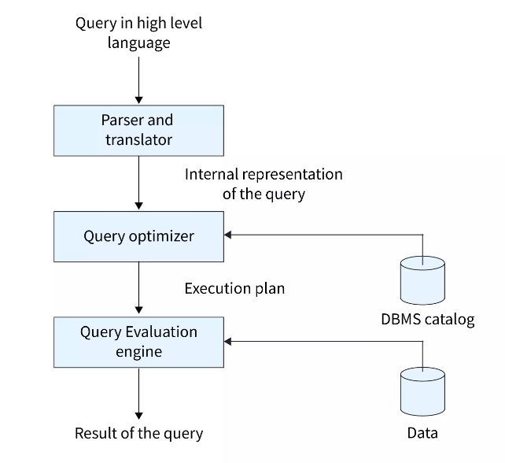
DATABASES AND APPLICATIONS
Query Optimization
Process Flow of Query Optimization

Slide 6
DATABASES AND APPLICATIONS
Query Optimization
In Query Optimization the Query parsing is a process by which the decision making is done that for a given query, calculating how many different ways the query can run, then the parsed query is delivered to the query optimizer, which generates various execution plans to analyze the parsed query and select the plan with the lowest estimated cost.
The catalog manager assists the optimizer in selecting the optimum plan to perform the query by generating the cost of each plan.

Slide 7
DATABASES AND APPLICATIONS
Query Optimizer
The optimizer tries to come up with the best execution plan possible for a SQL statement.
Among all the candidate plans reviewed, the optimizer chooses the plan with the lowest cost.
The optimizer computes costs based on available facts.
The cost computation takes into account query execution factors such as I/O, CPU, and communication for a certain query in a given context.

Slide 8
DATABASES AND APPLICATIONS
Query Optimizer
Optimizer Components
The optimizer is made up of three parts:
Transformer,
Estimator,
Generator.
The query transformer determines whether it is advantageous to rewrite the original SQL statement into a semantically equivalent SQL statement at a lower cost for some statements.

Slide 9
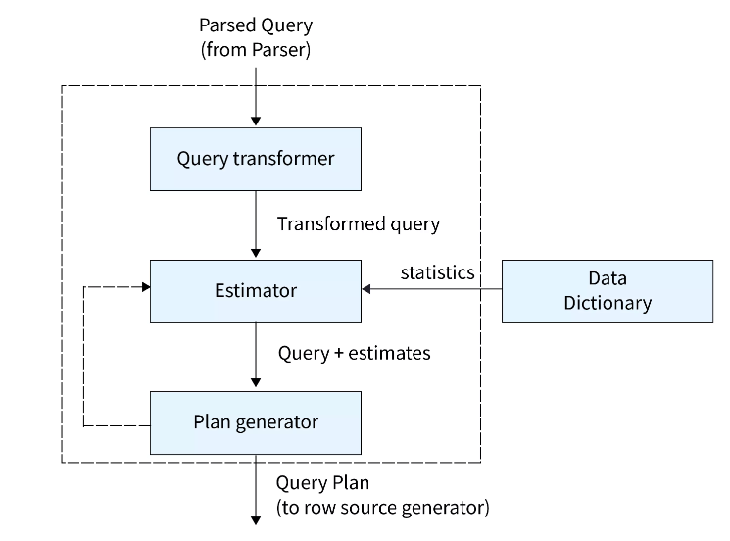
DATABASES AND APPLICATIONS
Query Optimizer

Slide 10
DATABASES AND APPLICATIONS
Query Optimizer
Minimize the use of wildcard characters
SELECT * FROM customers WHERE last_name_city LIKE 'P%’;
SELECT * FROM customers WHERE last_name_city >= 'P' AND last_name < 'Q’;
2. Increase Query Performance with Indexes
SELECT * FROM orders WHERE customer_number = 2154;
CREATE INDEX idx_orders_customer_number ON orders (customer_id);
3. Use appropriate data types
4. Avoid subqueries
5. Avoid using SELECT *
6. Use EXISTS instead of IN
7. Use GROUP BY to group data
8. Use stored procedures
9. Optimize the database design

Slide 11
DATABASES AND APPLICATIONS
Query Optimizer
7. Use GROUP BY to group data
8. Use stored procedures
9. Optimize the database design
10. Use query optimization tools
11. Monitor query performance
12. Use LIMIT or TOP to limit the number of rows returned
SELECT Name from employee where location='BNG’;
SELECT Name from employee where location='BNG' limit 1;

Slide 12

THANK YOU
Samyukta D Kumta
Department of Computer Applications
samyuktad@pes.edu

